Slide 1

Traffic Sign Recognition
A Deep Learning-Based Image Classification Project
Presented by: MUHAMMAD MARZAN HUSSAIN
Department of CSE
Date: 10. 07. 2025

Slide 2



Introduction to TSR
What is TSR?
Why is it important?
Ensuring safety
Classifying traffic signs from images using computer vision.
Crucial for autonomous vehicles and driver assistance systems.
Enhances road safety and compliance with traffic regulations.

Slide 3
Project Objectives
1
CNN Development
2
Accurate Classification
Build and train a Convolutional Neural Network.
Classify 43 types of traffic signs with high
accuracy.
3
Real-time Prediction
4
Interactive Interface
Enable predictions from uploaded images via a web application.
Create a Streamlit-based web app for user interaction.

Slide 4
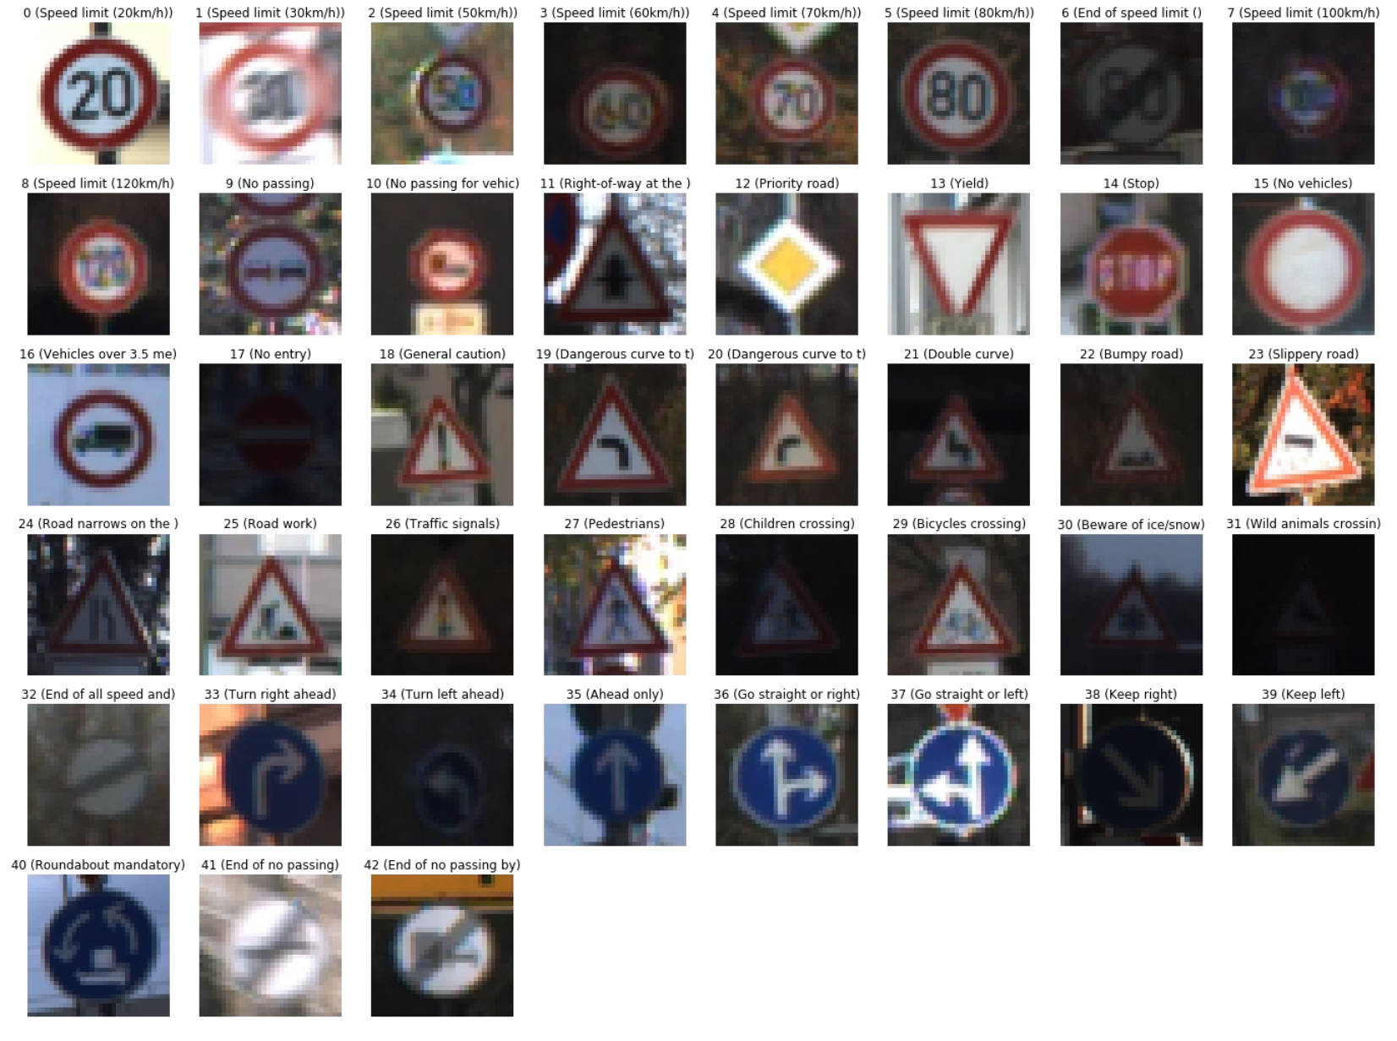
Dataset Overview
The project utilises the widely-recognised GTSRB (German Traffic Sign Recognition Benchmark) dataset.
39,209
43
Total images
Traffic sign classes
128x128
Image size in pixels

Slide 5
Data Preprocessing
Structure Flattening
Extraction
Nested directory structure organised for
processing.
ZIP files extracted from Google Drive.
Categorical Labelling
Auto-labeling & Batching
Applied with shuffling for both training and validation sets.
image_dataset_from_directory() used for efficiency.

Slide 6
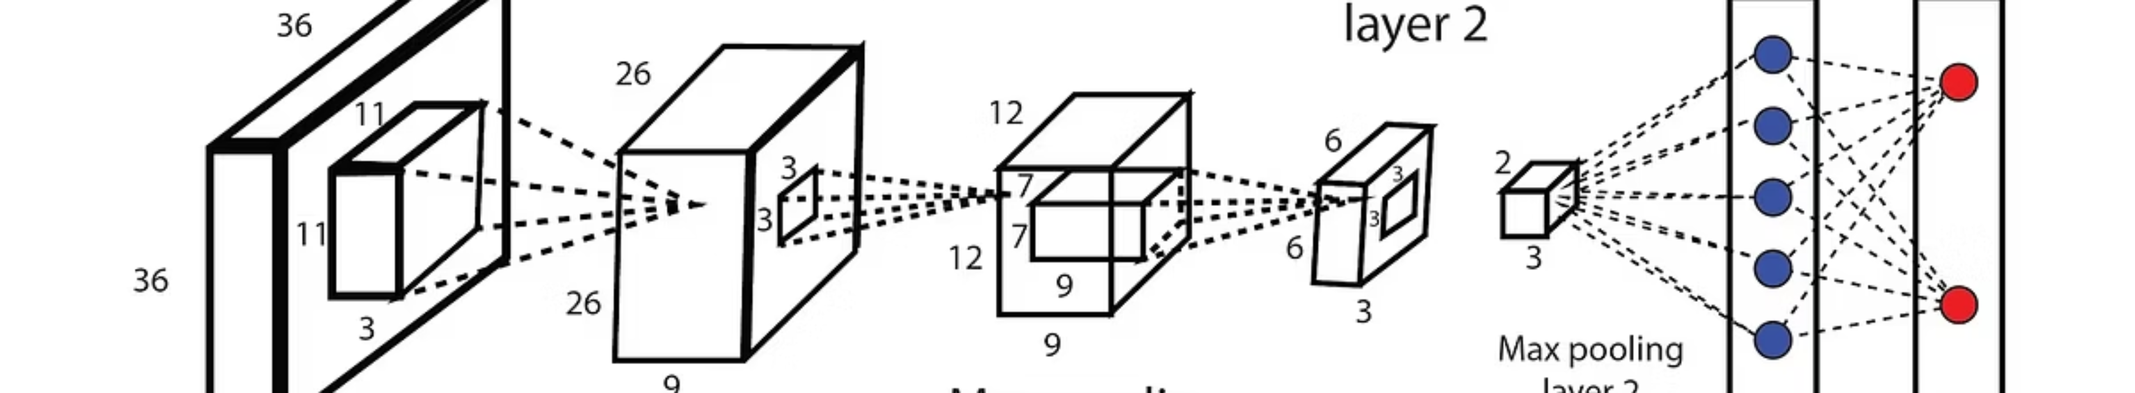
CNN Model Architecture
Our Convolutional Neural Network is designed for robust image classification.
Input: 128x128 RGB images
Optimizer: Adam (learning rate=0.0001)
Layers:
Loss Function: Categorical Crossentropy
4 convolutional blocks (Conv2D + MaxPool)
Activation Functions:
Flatten layer
ReLU for hidden layers
Dense layer with 1500 units
Softmax for the output layer
Output layer with 43 units (Softmax)

Slide 7
Model Summary
Detailed breakdown of the CNN's layers and parameters.

Slide 8
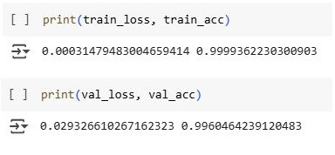
Training Performance
The model demonstrated strong performance during training over 10 epochs.
99.9%
Training Accuracy
99.6%
Validation Accuracy
The model's accuracy improved consistently across epochs, indicating effective learning and generalisation without significant overfitting.

Slide 9

Conclusion & Future Work
Key Accomplishments
Future Directions
Successfully trained CNN for 43 traffic sign classes.
Implement live camera feed prediction.
Achieved strong validation accuracy.
Integrate diverse datasets from other countries.
Developed an interactive Streamlit web application for real-time testing.
Add bounding box detection for comprehensive object recognition.
This project lays the groundwork for more advanced autonomous vehicle systems.
Explore transfer learning for enhanced performance.

Slide 10
Thank You
Any Questions!

